Slide 1
Mealy and Moore Models of Finite State Machines
The most general model of a sequential circuit has inputs, outputs, and internal states. It is customary to distinguish between two models of sequential circuits: the Mealy model and the Moore model. They differ only in the way the output is generated.

Slide 2
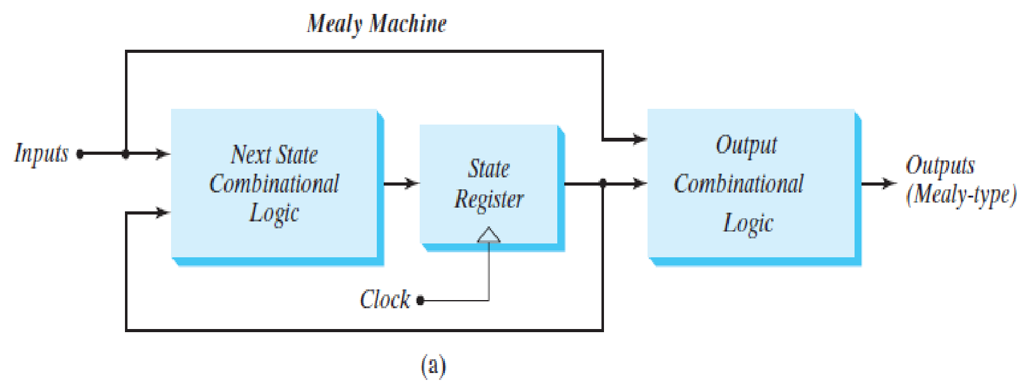
Mealy Model
In the Mealy model, the output is a function of both the present state and the input.

Slide 3
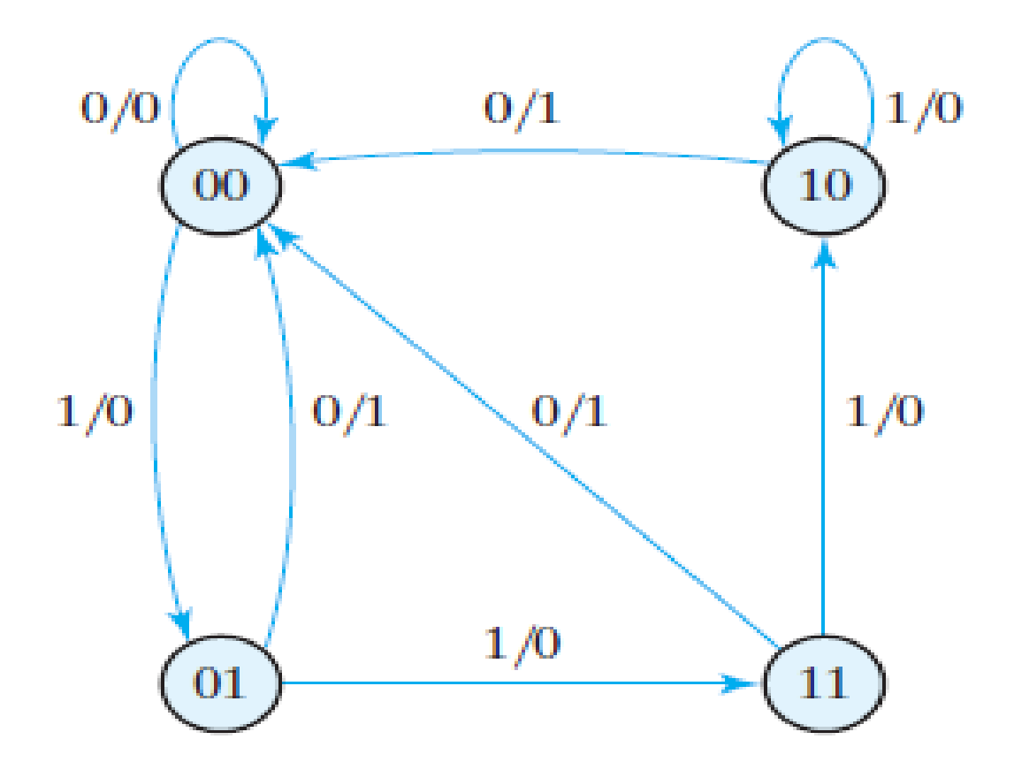
Example:
State Diagram:
Both the input and output values are shown, separated by a slash along the directed lines between the states.

Slide 4
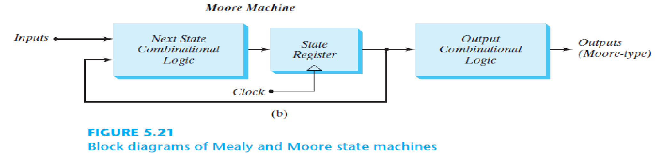
Moore Model
In the Moore model, the output is a function of only the present state.
A circuit may have both types of outputs.
The two models of a sequential circuit are commonly referred to as a finite state machine, abbreviated FSM.

Slide 5
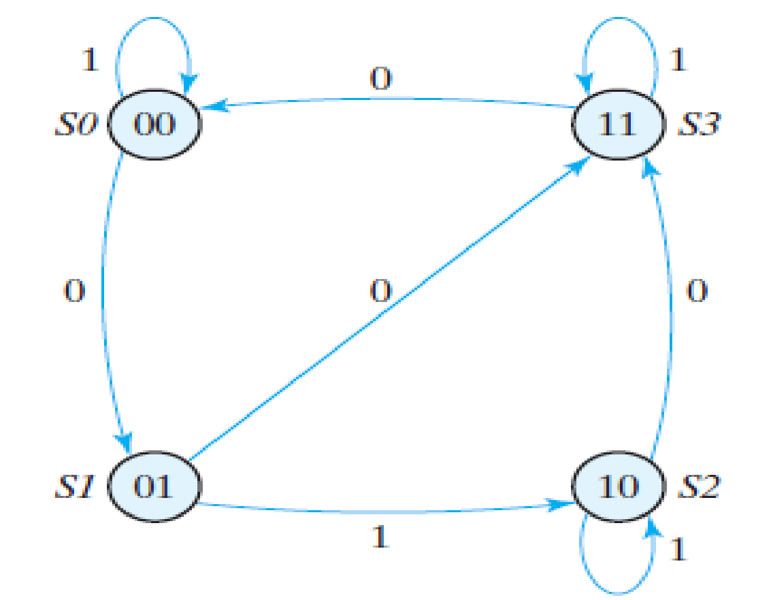
Example:
State Diagram:
It has only inputs marked along the directed lines. The outputs are the flip-flop states marked inside the circles. There may be other outputs also, which are functions of present state only.

Slide 6
Design a circuit that meets the following specification:
1. The circuit has one input, w, and one output, z.
2. All changes in the circuit occur on the positive edge of the clock signal.
3. The output z is equal to 1 if during two immediately preceding clock cycles the input w was equal to 1. Otherwise, the value of z is equal to 0.
From this specification it is apparent that the output z depends on both present and past values of w.

Slide 7
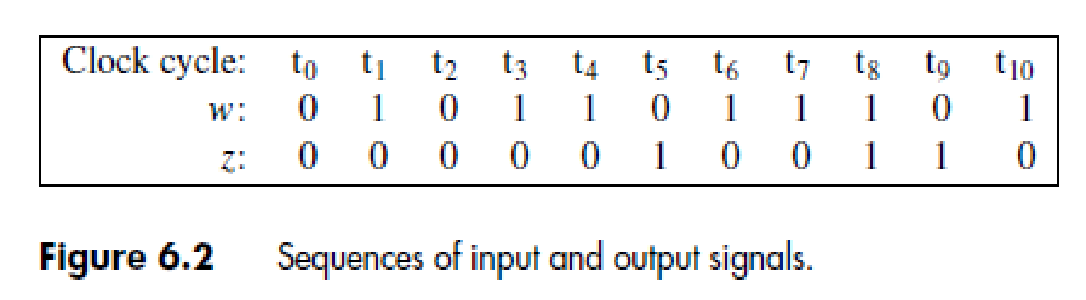
Consider the sequence of values of the w and z signals for the clock cycles shown in Figure 6.2.
As seen in the figure, for a given value of input w the output z may be either 0 or 1. For example, w = 0 during clock cycles t2 and t5, but z = 0 during t2 and z = 1 during t5. Similarly, w = 1 during t1 and t8, but z = 0 during t1 and z = 1 during t8. This means that z is not determined only by the present value of w, so there must exist different states in the circuit that determine the value of z.

Slide 8
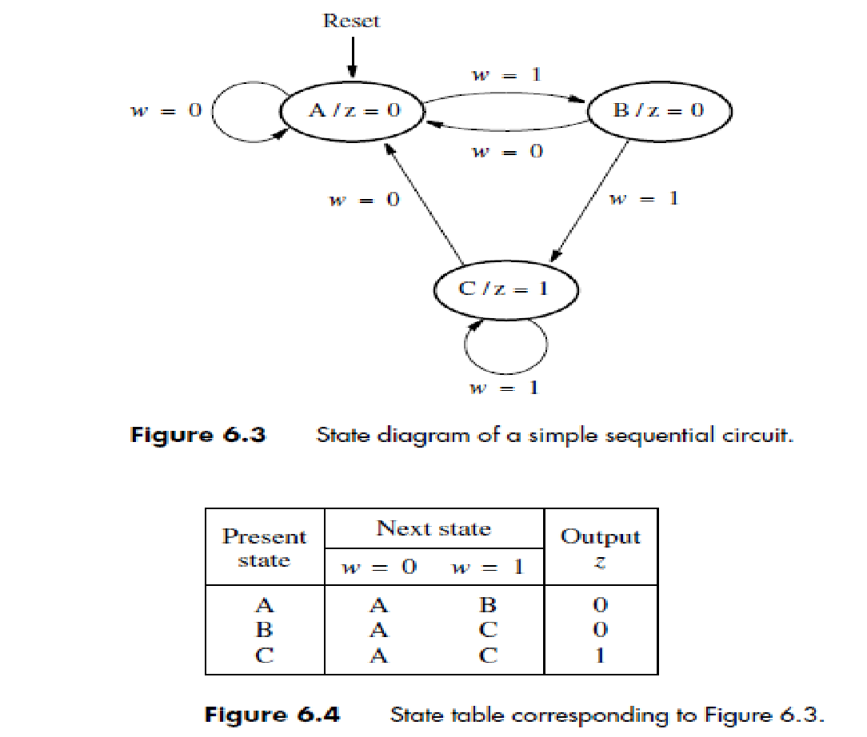
Reset input is used to force the circuit into state A, regardless of what state the circuit happens to be in.

Slide 9
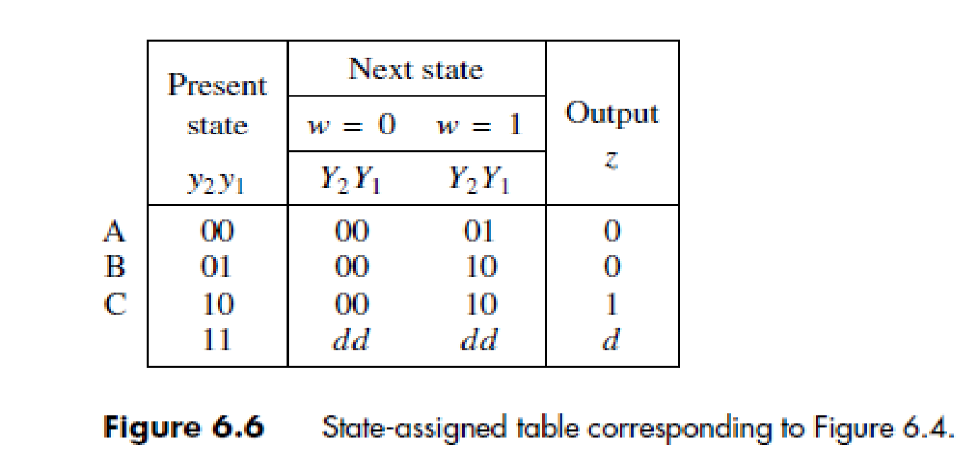
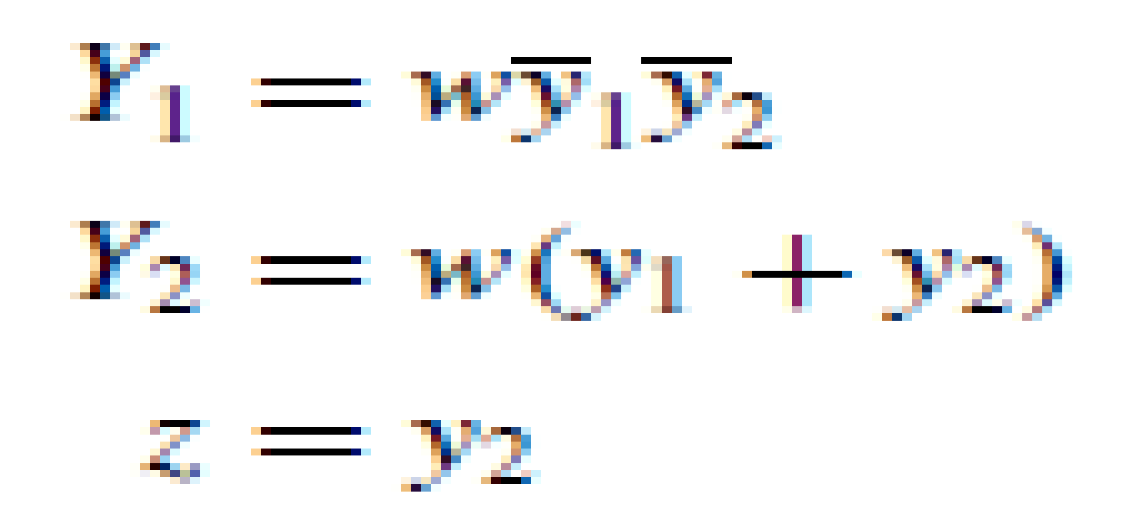

Slide 10
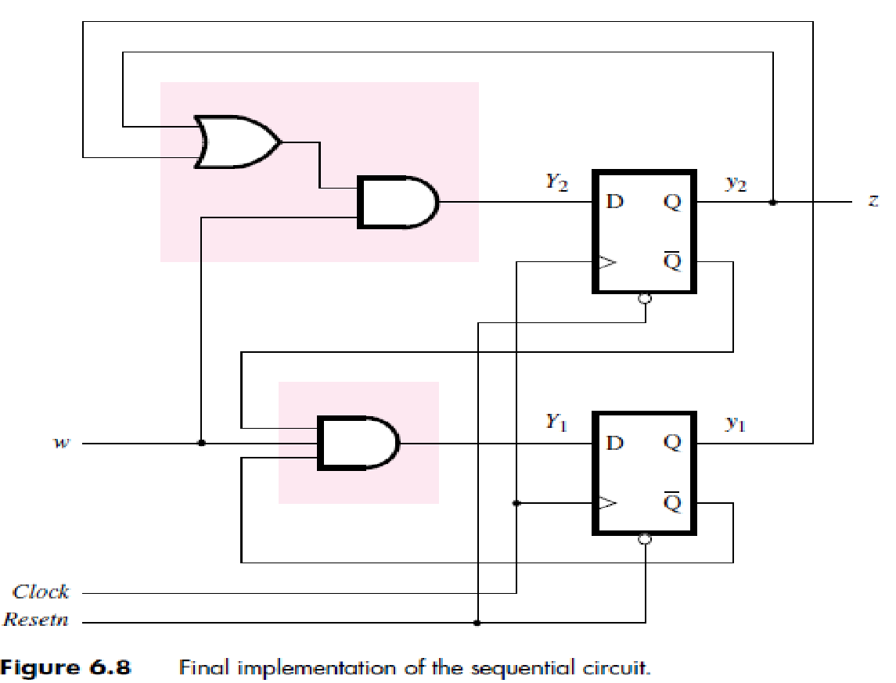

Slide 11
Using Verilog Constructs for Storage Elements
module flipflop (D, Clock, Q);
input D, Clock;
output reg Q;
always @(posedge Clock)
Q = D;
endmodule

Slide 12
Blocking and Non-Blocking Assignments
f = x1 & x2;
This notation is called a blocking assignment.
A Verilog compiler evaluates the statements in an always block in the order in which they are written.
If a variable is given a value by a blocking assignment statement, then this new value is used in evaluating all subsequent statements in the block.

Slide 13
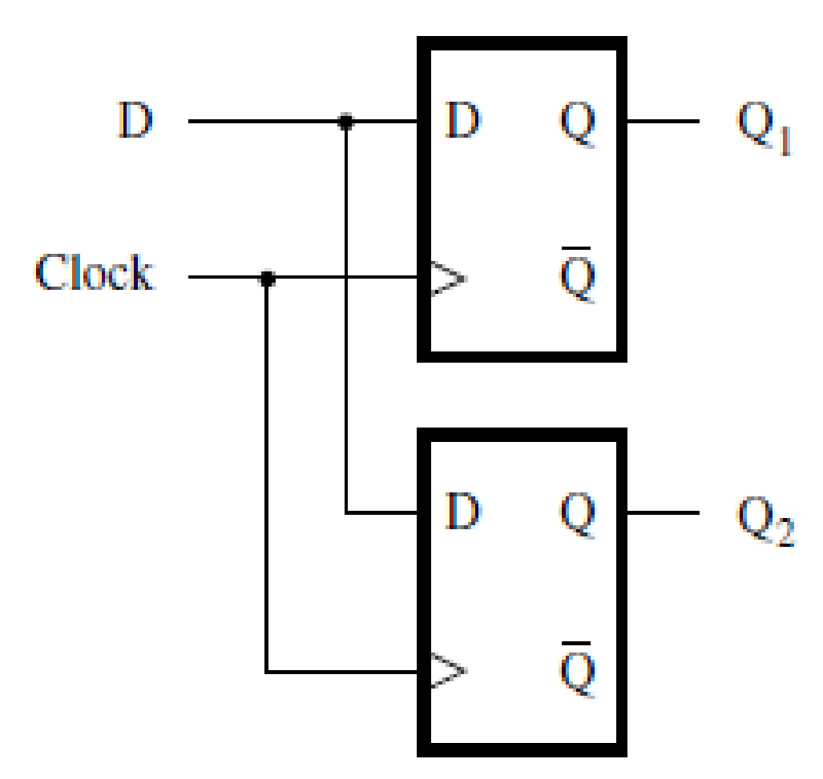
module example5_3 (D, Clock, Q1, Q2);
input D, Clock;
output reg Q1, Q2;
always @(posedge Clock)
begin
Q1 = D;
Q2 = Q1;
end
endmodule
Incorrect code for two cascaded flip-flops.

Slide 14
Since the always block is sensitive to the positive clock edge, both Q1 and Q2 will be implemented as the outputs of D flip-flops.
However, because blocking assignments are involved, these two flip-flops will not be connected in cascade.
The first statement Q1 = D; sets Q1 to the value of D. This new value is used in evaluating the subsequent statement
Q2 = Q1; which results in Q2 = Q1 = D.

Slide 15
Verilog also provides a non-blocking assignment, denoted with <=.
All non-blocking assignment statements in an always block are evaluated using the values that the variables have when the always block is entered.
Thus, a given variable has the same value for all statements in the block.
The meaning of non-blocking is that the result of each assignment is not seen until the end of the always block.

Slide 16
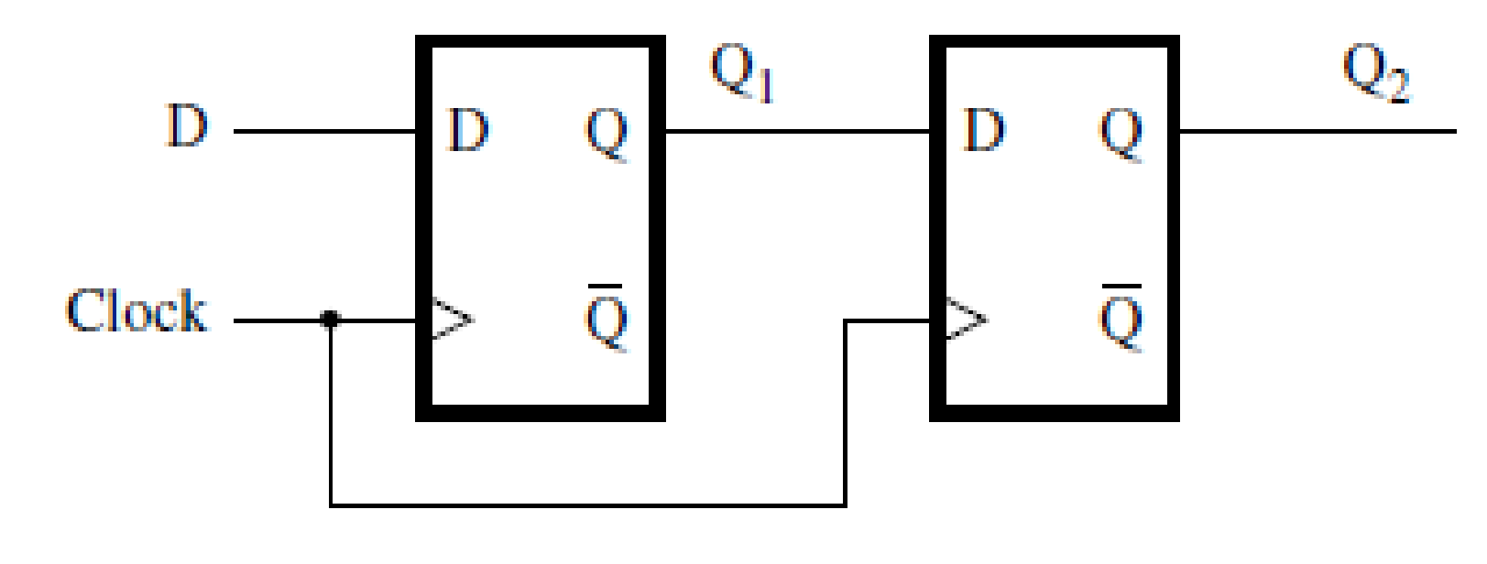
module example5_4 (D, Clock, Q1, Q2);
input D, Clock;
output reg Q1, Q2;
always @(posedge Clock)
begin
Q1 < = D;
Q2 < = Q1;
end
endmodule

Slide 17
module example5_5 (x1, x2, x3, Clock, f, g);
input x1, x2, x3, Clock;
output reg f, g;
always @(posedge Clock)
begin
f = x1 & x2;
g = f | x3;
end
endmodule

Slide 18
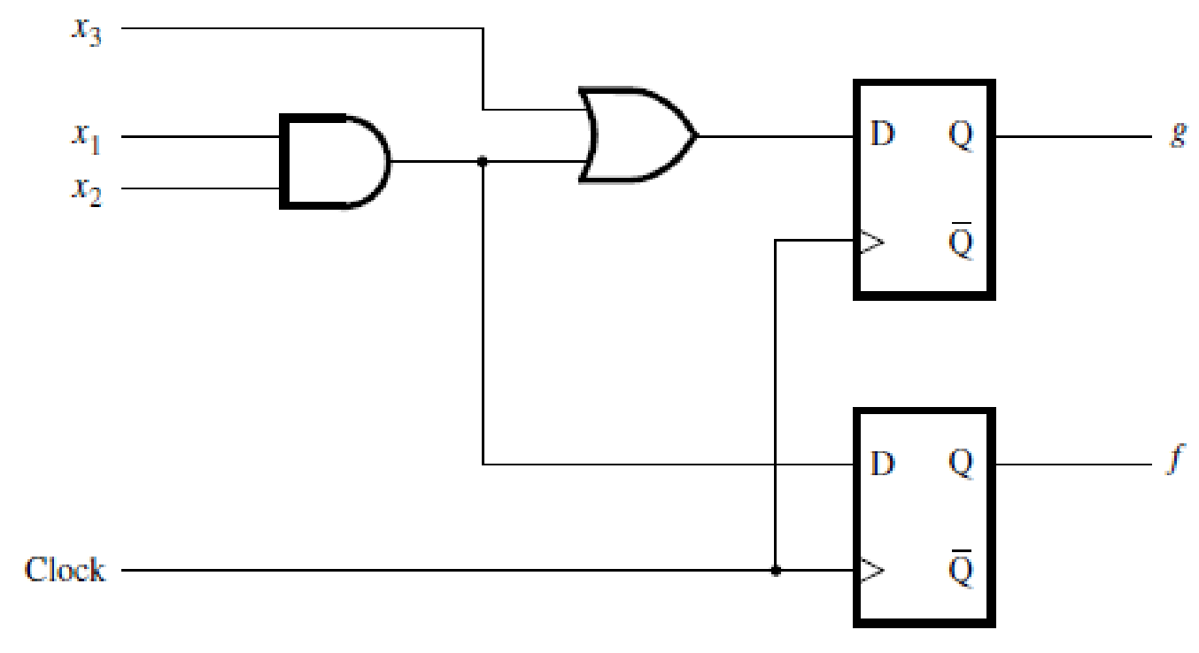

Slide 19
module example5_6 (x1, x2, x3, Clock, f, g);
input x1, x2, x3, Clock;
output reg f, g;
always @(posedge Clock)
begin
f < = x1 & x2;
g < = f | x3;
end
endmodule

Slide 20
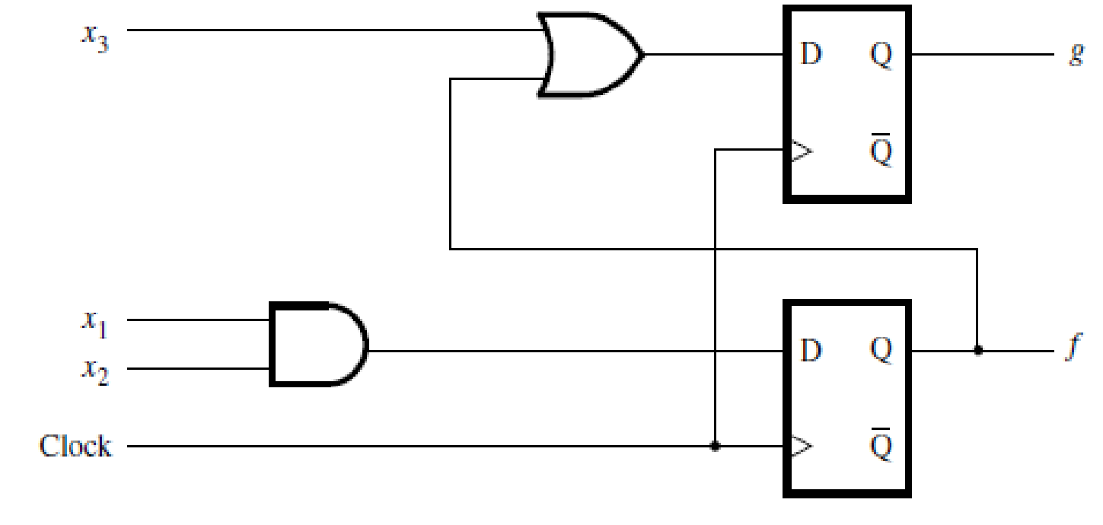

Slide 21
ASYNCHRONOUS CLEAR
Following module defines a D flip-flop with an asynchronous active-low reset (clear) input.
When Resetn, the reset input, is equal to 0, the flip-flop’s Q output is set to 0.
The sensitivity list specifies the negative edge of Resetn as an event trigger along with the positive edge of the clock.
We cannot omit the keyword negedge because the sensitivity list cannot have both edge-triggered and level sensitive signals.

Slide 22
module flipflop (D, Clock, Resetn, Q);
input D, Clock, Resetn;
output reg Q;
always @(negedge Resetn or posedge Clock)
if (!Resetn)
Q <= 0;
else
Q <= D;
endmodule

Slide 23
SYNCHRONOUS CLEAR
Module below shows how a D flip-flop with a synchronous reset
input can be described.
In this case the reset signal is acted upon only when a positive clock edge arrives.
module flipflop (D, Clock, Resetn, Q);
input D, Clock, Resetn;
output reg Q;
always @(posedge Clock)
if (!Resetn)
Q <= 0;
else
Q <= D;
endmodule

Slide 24
module regn (D, Clock, Resetn, Q);
parameter n = 16;
input [n –1:0] D;
input Clock, Resetn;
output reg [n –1:0] Q;
always @(negedge Resetn, posedge Clock)
if (!Resetn)
Q <= 0;
else
Q <= D;
endmodule

Slide 25
module shift4 (w, Clock, Q);
input w, Clock;
output reg [3:0] Q;
always @(posedge Clock)
begin
Q[0] < = Q[1];
Q[1] < = Q[2];
Q[2] < = Q[3];
Q[3] < = w;
end
endmodule
for (k = 0; k < n –1; k = k+1)
Q[k] < = Q[k+1];
Q[n –1] <= w;

